Slide 1

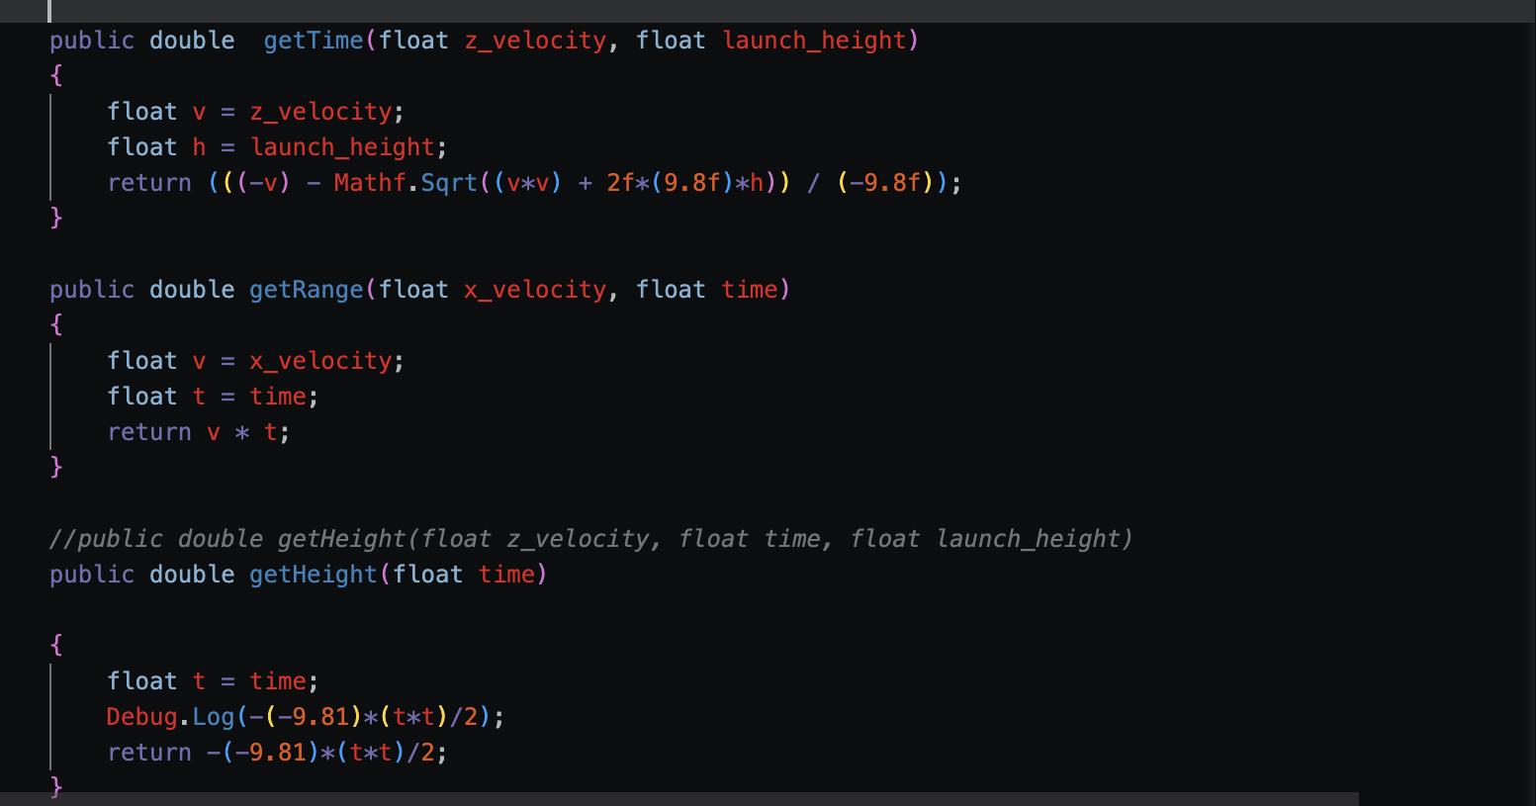
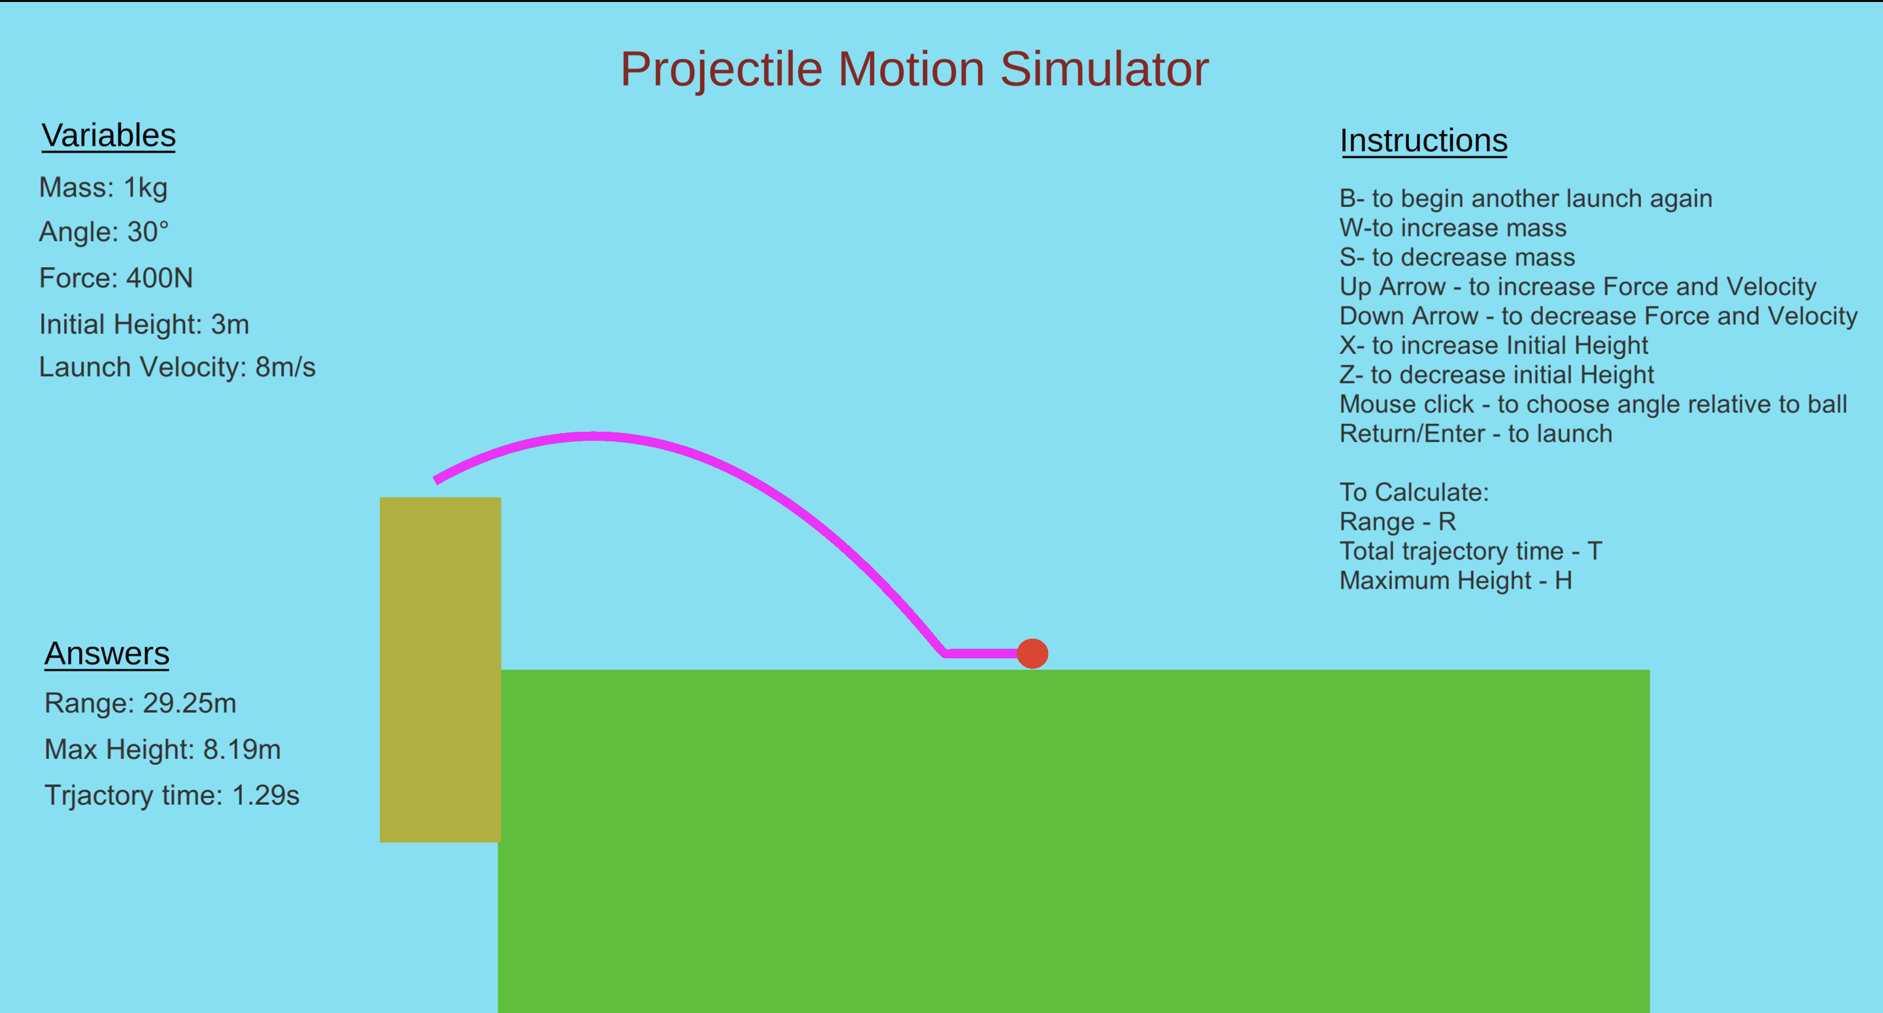
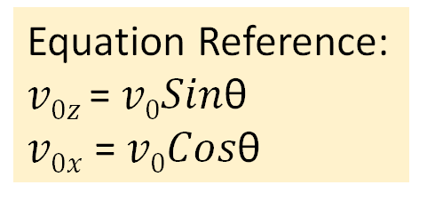
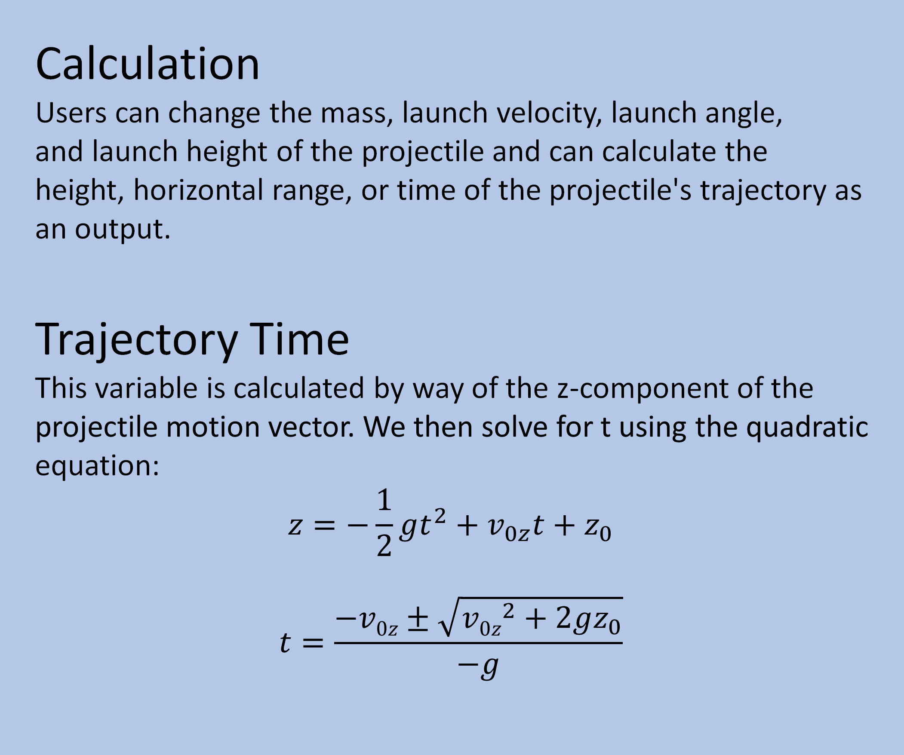
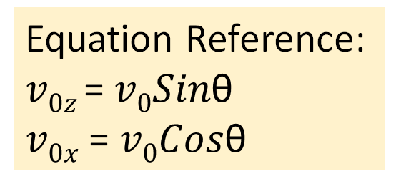
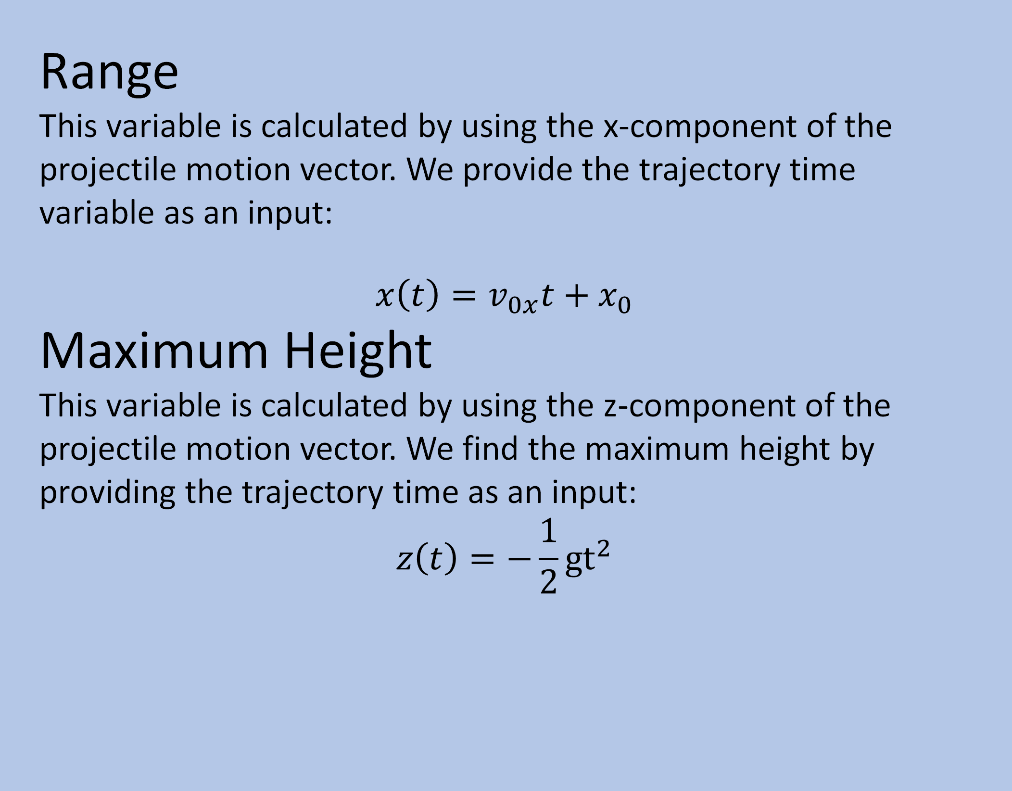
Simple Projectile Motion Simulator Interface
Adria Bower and Bezawit Mekasha Kassaye
Mathematical and Physical Sciences Department, The College of Idaho
What is a Simple Projectile Motion?
Projectile motion is a motion in which the force that an object experiences is only force of gravity. Simple projectile motion is a projectile motion where we assume that air resistance is negligible, gravity vector has constant direction and magnitude, the projectile is relatively close to the surface of the Earth and its trajectory is relatively short.
Why a simulator?
We created a simulator to provide an easier visual illustration of a projectile motion to help users understand the concept better. A computer simulator interface allows users to change certain variables to see the effect it has on the trajectory of the motion. It is also a fun way to learn about projectile motion, especially for people who might not necessarily have a strong physics background, or for people who are visual learners instead.
Range
This variable is calculated by using the x-component of the projectile motion vector. We provide the trajectory time variable as an input:
$$x\left(t\right)=v_{0x}t+x_{0}$$
Maximum Height
This variable is calculated by using the z-component of the projectile motion vector. We find the maximum height by providing the trajectory time as an input:
$$z\left(t\right)=−\frac{1}{2}{gt}^{2}$$
Equation Reference:
$v0z$= $v0Sin\text{θ}$
$v0x$ = $v0Cos\text{θ}$
Figure 1: A screenshot of an excerpt of code that shows how we integrated our projectile motion equations into our coding language, C#, using Visual Studio Code.
So far, we have managed to create a functioning simple application that outputs
Range,
Maximum Height and
Trajectory Time.
Users have abilities to control the Mass, Force, Velocity, Initial Height and Launch Angle of the projectile motion.
Equation Reference:
$v0z$= $v0Sin\text{θ}$
$v0x$ = $v0Cos\text{θ}$
Calculation
Users can change the mass, launch velocity, launch angle, and launch height of the projectile and can calculate the height, horizontal range, or time of the projectile's trajectory as an output.
Trajectory Time
This variable is calculated by way of the z-component of the projectile motion vector. We then solve for t using the quadratic equation:
$$z=−\frac{1}{2}gt^{2}+v_{0z}t+z_{0}$$
$$t=\frac{−v0z±\sqrt{v0z^{2}+2gz_{0}}}{−g}$$
Creating the Interface
We developed an interface using the software Unity 2022.1.22, which is a product of a video game software development company. It works with Visual Studio Code serving as a platform to create our simulator, and it uses C# programming language.
The steps we took
We created objects to serve as the ground, the launch point, and the ball.
The ball was given code that allowed it to be launched in the direction of the mouse upon clicking the screen.
Its mass, launch angle, initial height, initial velocity and initial launch force were all made to be adjustable.
The launch point object was given code that would allow it to move up and down, changing the initial launch height. All variables, both dependent and independent, are recorded by text UI placed on the left side of the screen.
Future Work:
Include more calculable variables
Make it more user friendly
Give user ability to change object
Make it more visually appealing
References and Acknowledgments
Projectile motion. (n.d.). PhET. Retrieved December 9, 2022, from https://phet.colorado.edu/en/simulations/projectile-motion
Using C# to launch projectiles. (n.d.). Unity Learn. Retrieved December 9, 2022, from https://learn.unity.com/tutorial/using-c-to-launch-projectiles
What is a Projectile? (n.d.). Retrieved December 9, 2022, from https://www.physicsclassroom.com/class/vectors/Lesson-2/What-is-a-Projectile
Figure 2: Screenshot of the working simulator app in progress.
Figure 3: The finished executable file, ready to to be run by any computer.

